Slide 1
Chapter – 2
Instrumentation
Types of instruments
Active and passive instruments
Instruments are divided in to active and passive once according to whether the instrument out put is entirely produced by the quantity being measured or whether the quantity being measured simply modulates the magnitude of external power source.
Active instruments
The instrument in which the quantity to be measured just activates the magnitude of some external power input source which in turn produces the measurement (instrument output).

Slide 2
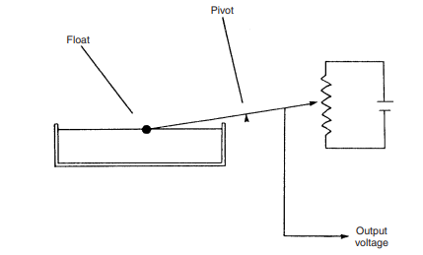
Example for active instruments is float–type petrol tanker level
The change in petrol level moves a potentiometer arm and the output signal consists of proportion of external voltage source applied across the two ends of potentiometer .
The output signal consists of proportion of the meter reading which varies according to the position of the float.

Slide 3
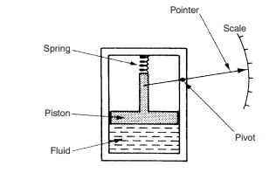
Passive instruments
The instruments in which the output is produced entirely by the quantity being measured are called passive instrument.
Best example for passive instrument is pressure gauge
The pressure of fluid is translated in to movement of pointer against scale. The energy expanded in a moving the pointer is derived entirely from the change in pressure measured. There is no external input to the system.

Slide 4
Difference between active and passive instruments
Active
Passive
The quantity to be measured activates some external power (input source)which turn produces the output.
Additional external energy input is required .
The resolution can be adjusted by the adjusting the magnitude of the external input.
The out put is entirely produced by the quantity being measured .
Additional external energy input is not required .
The resolution can not be easily adjusted.

Slide 5
Null-type and delectation-type instrument
Null-type instrument
An instrument in which zero or null indication determines the magnitude of measured quantity such type of instrument is called a null type instrument.
It uses a null detector which indicating the null condition when the measured quantity and the opposite quantity are same.
Null-type instrument condition requires
The effect produced by the measurement of measured quantity.
The opposing effects whose value are accurately known.
A detector which detects the null conditions(null detector )

Slide 6
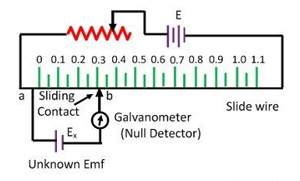
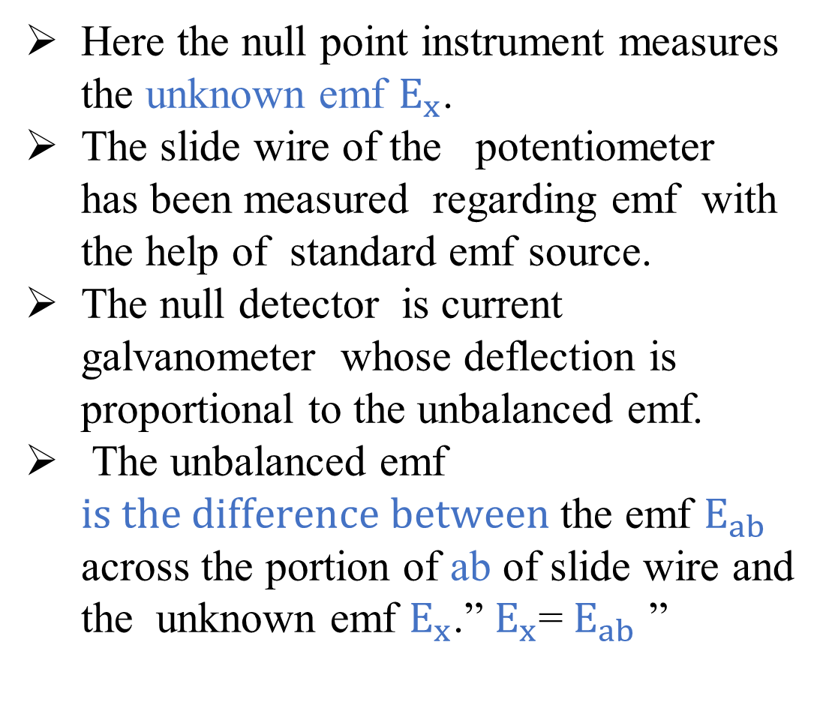
Example of null type instrument is Dc potentiometer
Here the null point instrument measures the unknown emf $E_{x}$.
The slide wire of the potentiometer has been measured regarding emf with the help of standard emf source.
The null detector is current galvanometer whose deflection is proportional to the unbalanced emf.
The unbalanced emf $is the difference between$the emf $E_{ab}$ across the portion of ab of slide wire and the unknown emf $E_{x}$.” $E_{x}$= $E_{ab}$ ”

Slide 7
Advantage of null type instruments
The accuracy of null type instruments are higher. Because the opposing effect is calibrated with the standards that have higher degree of accuracy.
The null type instrument are higher sensitive. That mean the measured quantity is balanced out. This means the detector has to cover a small range around the balance(null )point.
Disadvantage of null type instruments
The detector not to be calibrated since it has only to detect the presence and direction of the unbalance and not the magnitude of the unbalance.
The response time is slower than deflection type instruments.

Slide 8
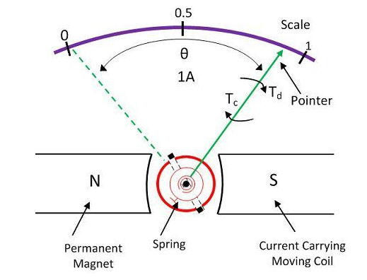

Deflection-type instruments
The instrument in which the deflection provides the basis for measuring the electrical quantity is known as the deflection type instrument. Or the measured quantity produces physical effects which deflect or displace the moving system of the instruments.
Example of Deflection type instrument is permanent magnet moving coil ammeter.
Moving coil carries a current its placed on the permeant magnate. Here due to the interaction their will have a flux and the coil moves. Then the pointer deflected under the effect of deflection torque.
$$θ\sim current$$

Slide 9
Advantage of deflection type instruments
Deflection type of instruments have a faster response than null type
It is simple to read the position of the pointer according to the scale.
Disadvantage of deflection type instruments
The accuracy of the instruments is low.
The sensitivity of the instruments is less than the null type instruments. Because the detector has to cover a big
range around the balanced point .

Slide 10
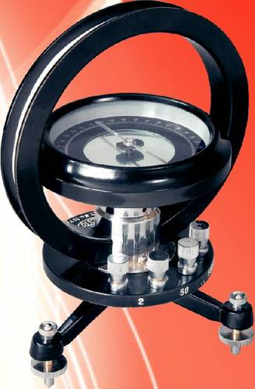
Absolute and secondary instrument
Absolute instruments
The value of the quantity to be measured is in terms of the constants of the instrument and their deflection only. No previous calibration or comparison is necessary in absolute instruments.
Best example of absolute instrument tangent galvanometer.
Tangent galvanometer which gives the value of current, in terms of the tangent of deflection produced by the current, the radius and number of turns of wire used and the horizontal component of earth’s field.

Slide 11
Secondary instruments
The value of electrical quantity to be measured can be determined from the deflection of the instruments, only when they have been pre-calibrated by comparison with an absolute instrument.
N.B Without calibration, the deflection of such instruments is meaningless.
Secondary instrument categories in to three parts
Indicating
Integrating
Recording

Slide 12
Indicating instruments
Indicating instrument indicate the magnitude of unknown quantity when its being measured use a pointer that moves over a calibrated scale.
Example: ammeter, voltmeters and wattmeter.
Integrating instruments
Integrated instrument are those which measure the total quantity of electricity delivered in particular period of time.
Example :ampere per hour or watt per hour
Recording instruments
Recording instruments are those which gives a continuous recording of the variations of on electrical quantity over a selected period of time.

Slide 13
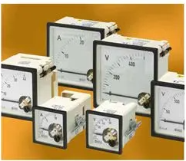
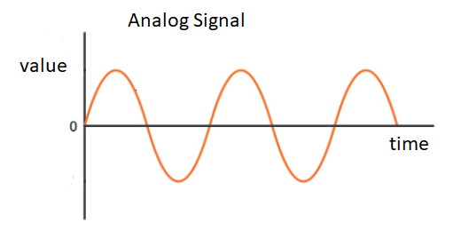
Analogue and digital instruments
Analogue instruments
Analogue instruments which gives output that varies continuously as quantity to be measured.

Slide 14
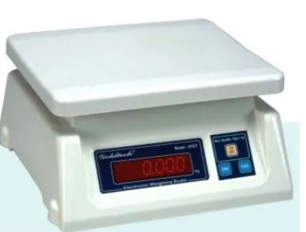
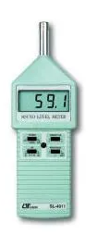
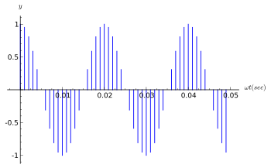
Digital instruments
Digital instruments which gives an out put in the form of discrete state.
Example for digital instruments

